Slide 1


Together for the New Style of IT
HP Enterprise Technology & Solutions Summit 2015
Dublin, Ireland June 15-19
#HPETSS

Slide 2
Daily operations with iMC
How to make your admin life easier with iMC
Fabien GIRAUD / June 19, 2015

Slide 3
Confidential Disclosure Agreement
The information contained in this presentation is proprietary to Hewlett-Packard Company and is offered in confidence, subject to the terms and conditions of a binding Confidential Disclosure Agreement (CDA)
HP requires customers and partners to have signed a CDA in order to view this training
The information contained in this training is HP confidential
This presentation is NOT to be used as a ‘leave behind’ for customers and information may only be shared verbally with HP-external customers under NDA
This presentation may be shared with HP Channel partners under NDA in hard-copy or electronic format for internal training purposes only
Do not remove any classification labels, warnings or disclaimers on any slide or modify this presentation to change the classification level.
Do not remove this slide from the presentation
HP does not warrant or represent that it will introduce any product to which the information relates
The information contained herein is subject to change without notice
HP makes no warranties regarding the accuracy of this information
The only warranties for HP products and services are set forth in the express warranty statements accompanying such products and services
Nothing herein should be construed as constituting an additional warranty
HP shall not be liable for technical or editorial errors or omissions contained herein
Strict adherence to the HP standards of business conduct regarding this classification level is critical.
HP Confidential - provided to HP employees and HP Partners for internal training purposes only
Notes:
Some of the information in this session may be confidential. If you are not an HP employee, you must have a confidential disclosure agreement on file with HP to participate in the remainder of this session. Partners and contract trainers that have these agreements in place are welcome to attend.
Next slide, please.

Slide 4
Abstract
Session to make you understand why and how iMC helps your life
AIMS
Why do we need to be helped in Network Admin / Support
What are the solutions ?
Why iMC ?
Live examples

Slide 5
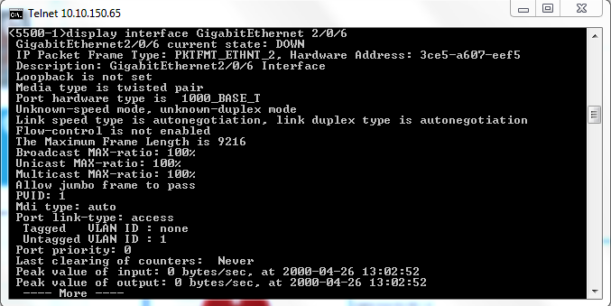



Introduction
1: Find where he is connected
Why do we need some help ?
Connection Point | Network Device | Interface
L2P21 | Level2-AccessSW-1 | gig 2/0/5
L2P22 | Level2-AccessSW-1 | gig 2/0/6
Typical situation:
2: Verify the configuration
3: If we are lucky, correct the issue through CLI
4: Call back the hotline so that they can call back end user and verify everything works now
Level 2 Support
Notes:
In this very simple example, this can take hours (even perhaps days if level 2 needs to connect on each switch to find where the user is connected)

Slide 6
Introduction
Why do we need some help ?
Support Team
Ideal situation 1:
Get the case
Fix
At the end, support team can close the ticket so that customer is automatically notified
Open a case
Network management tools
Notes:
This is a typical example when the issue is located on the end client part. So difficult to automatically detect in a monitoring tool (since this can’t manage all end client Ips)

Slide 7
Introduction
Why do we need some help ?
Ideal situation 1:
Support Team
Fix
Detect
Situation is fixed before the end user notices the issue
Network management tools
Notes:
This is a typical example of an issue located on the server side. Since the management tool manages also servers, it can automatically detects alarm on this.

Slide 8
Introduction
Solutions
To be able to solve this, we need
A monitoring tool which will monitor network performance, get alarms on the devices … and show this in an understandable way to the team
A service desk tool in order to manage some process when anomalies appear on the network
A management tool in order to bea ble to quickly make some corrective changes on the network from a central point
Some reporting tools to be able to keep an history, to generate some SLA, send some service reports …

Slide 9
Introduction
Why iMC
Just because with iMC we have all these tools in a single pane of glass !!!
FCAPS
Fault
Configuration
Accounting
Performance
Security
IMC Platform
Alarms
Syslog & Trap Mgr
Intelligent Configuration Center
Compliance Center
VLAN & ACL Manager
Network Assets
Performance
Mgmt
Virtual Network Mgmt
Security Control Center
Extended API
Add-On Modules
IPSec VPN Mgr
MPLS VPN Mgr
Wireless Services Mgr
QoS Mgr
Branch Intelli. Mgmt System
User Behavior Analyzer
Service Oper
Mgmt
Network Traffic Analyzer
App Perform. Manager
User Access Manager
Endpoint Admission Defense
VAN ConnectManager
Remote Site Manager
VAN Resource Automate Manager
VAN Fabric Manager
Intelligent Analysis Reporter
vMon
Service Health Manager
TACACS+ Authent Manager
UC Health
Manager
VAN SDN Manager

Slide 10
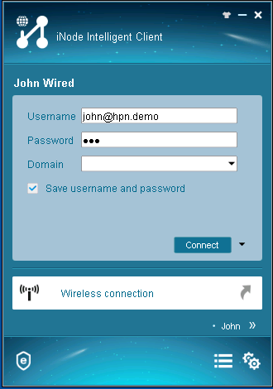
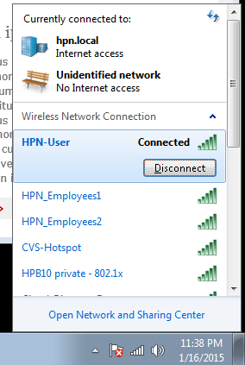
Demoer Task : Prerequisite – Connect users
Open RDP connection on 10.10.134.11 and connect (wired connection) John user with iNode
Open RDP connection on 10.10.0.98 and connect John user to Wireless SSID HPN-User

Slide 11
AGENDA
Scenario 1
Detect
Diagnose
Fix
Check
Scenario 2
Detect
Diagnose
Fix
Check
Scenario 3
Detect
Diagnose
Fix
Check
Notes:
If time, show the event correlation (root cause)

Slide 12
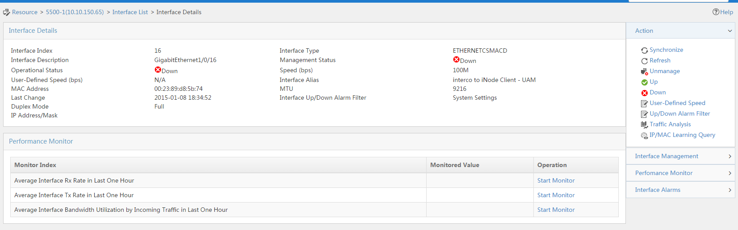
Demoer Task : disable connection port of John
Disable port GigabitEthernet 1/0/16 of 5500-1 device (10.10.150.65) using iMC

Slide 13
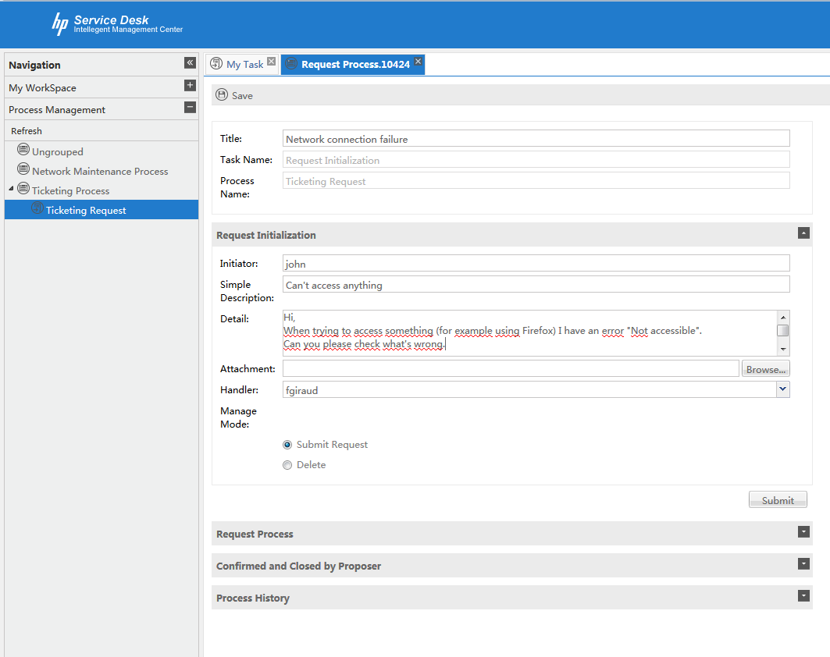
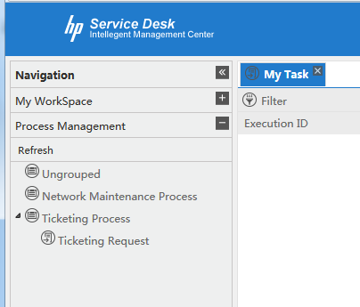
Scenario 1: Simple connection issue
End user detect an issue
The end user John can’t access anything anymore on the network →Open a case on iMC – SOM (http://10.10.105.21:8080/servicedesk/)
Notes:
Username: john / Password : hpn

Slide 14
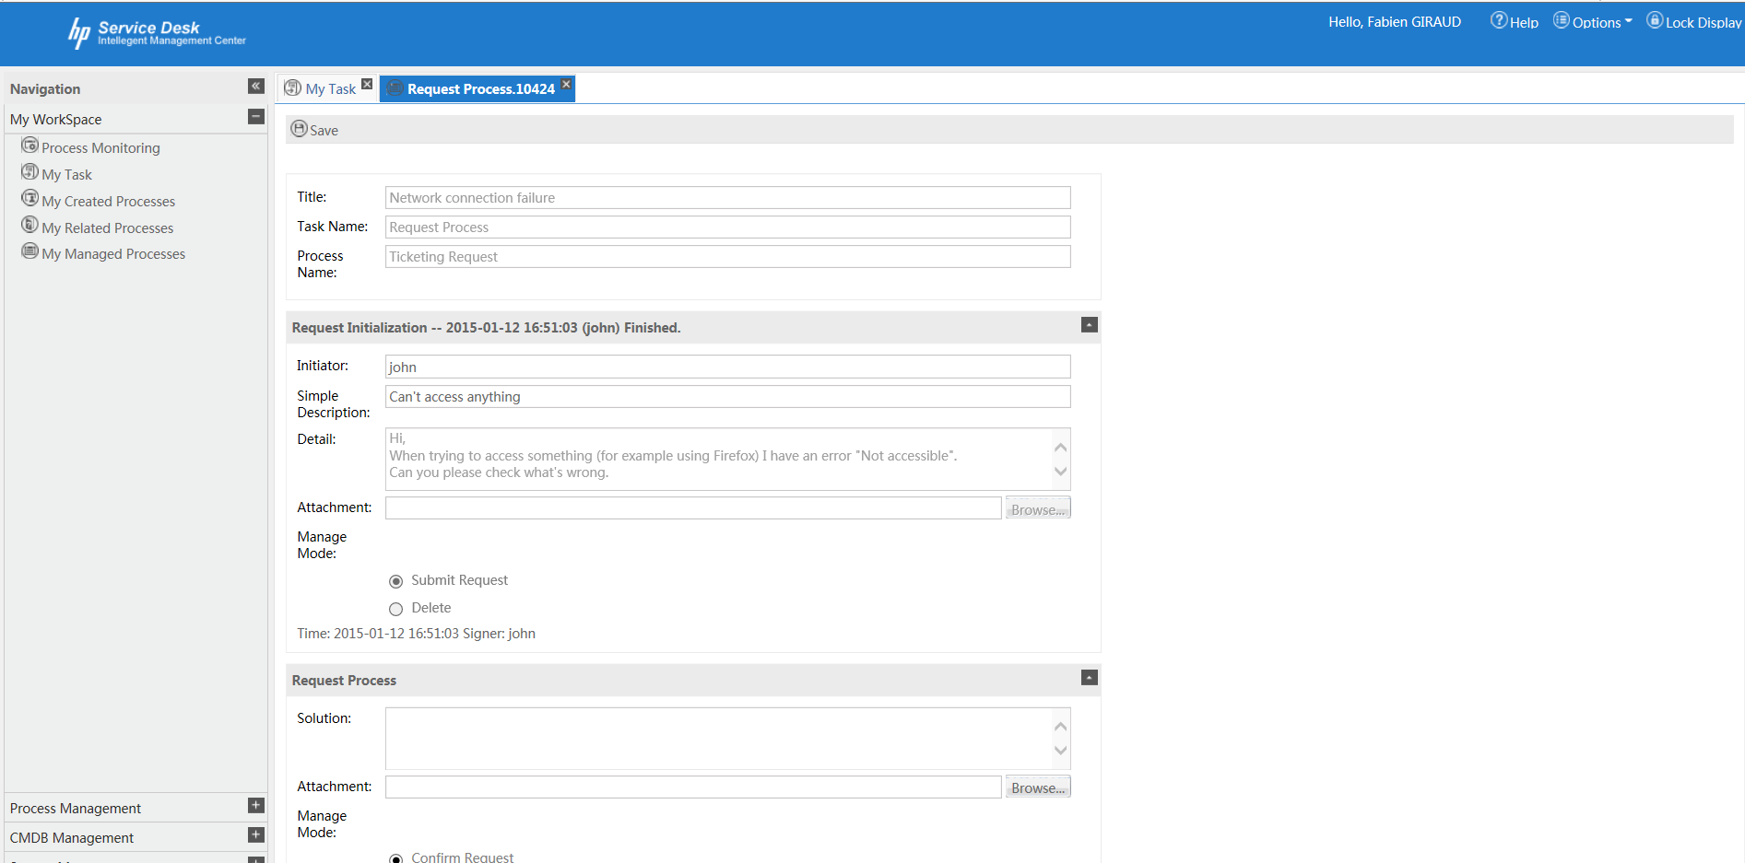
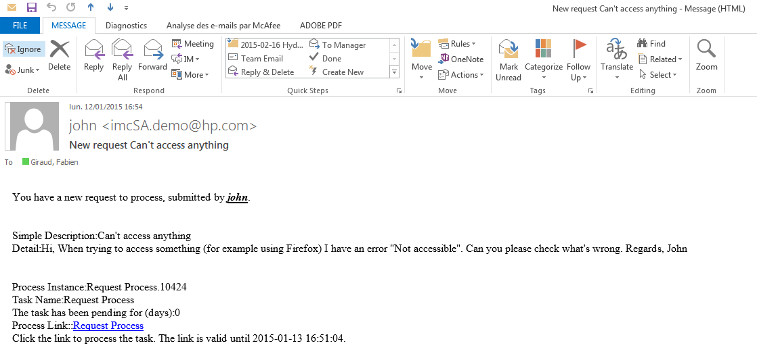
Scenario 1: Simple Connection issue
Admin team diagnostic
The Network support team receives an email:
Notes:
If needed, connect with network support user such as fgiraud / hpn or clinzell / hpn

Slide 15
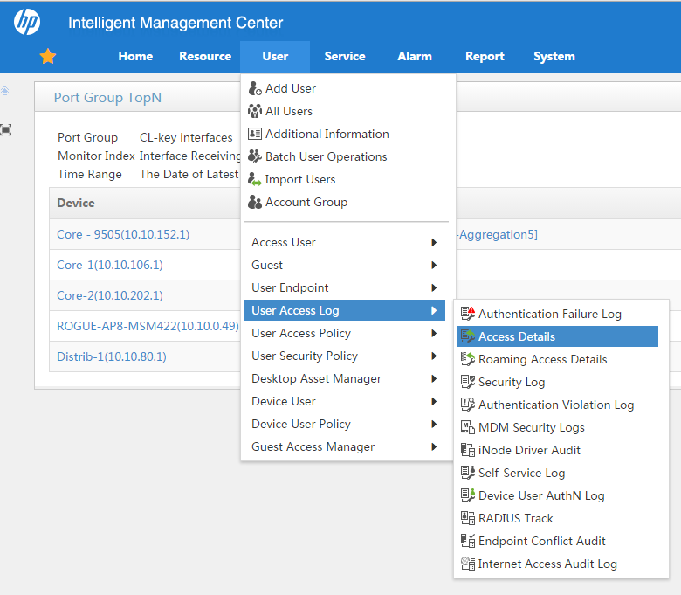
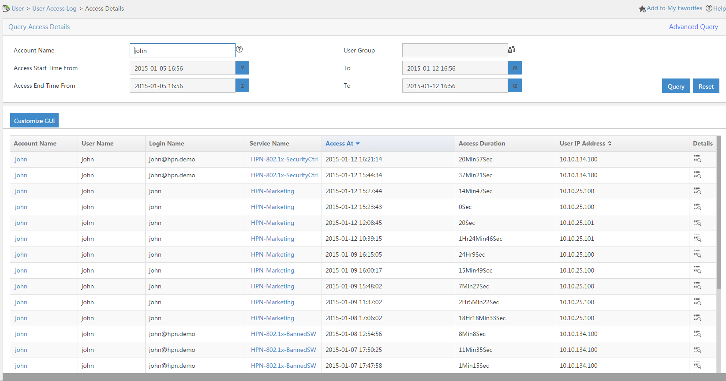
Scenario 1: Simple Connection issue
Admin team diagnostic
Apparently John can’t access the network !!! First let’s find him
We are lucky, John is an authenticated user (through iMC / UAM) → let’s find him in the access logs

Slide 16
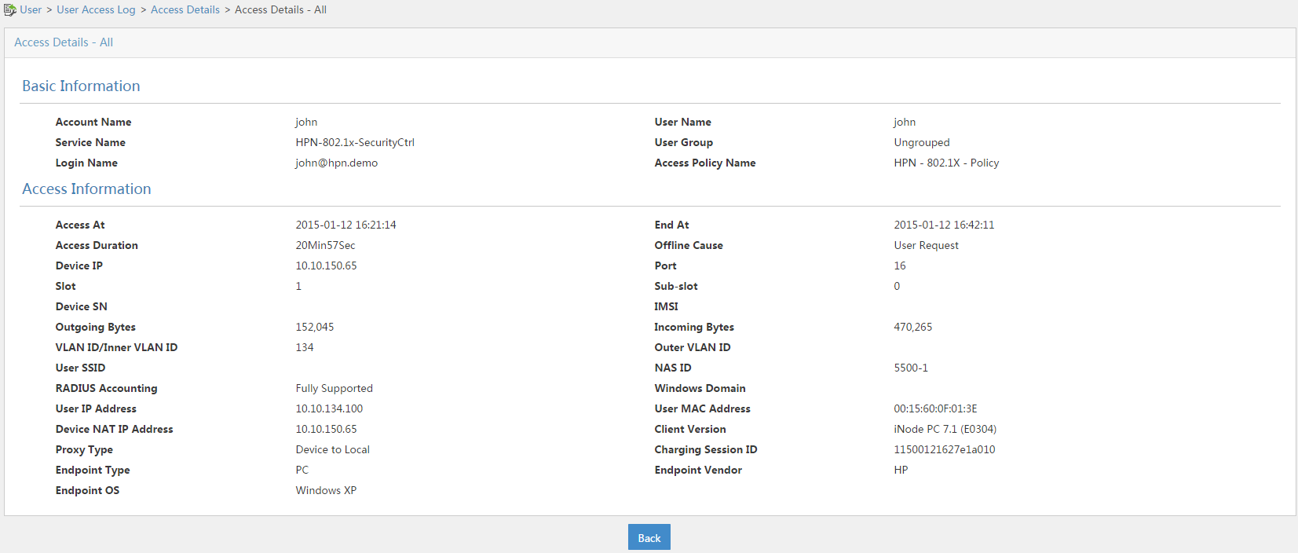
Scenario 1: Simple Connection issue
Admin team diagnostic
Access details show that John is connected on device 5500-1 (10.10.150.65) on port 16

Slide 17
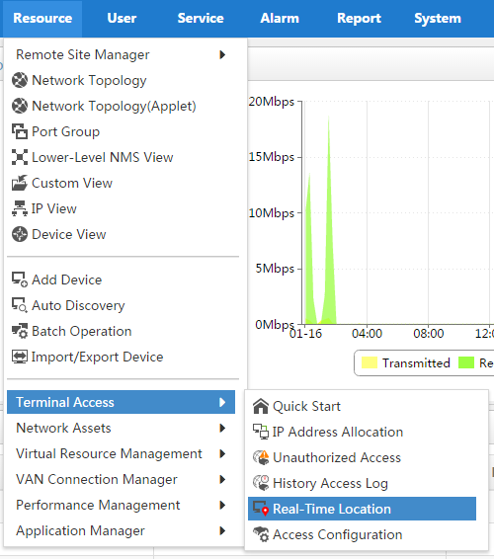
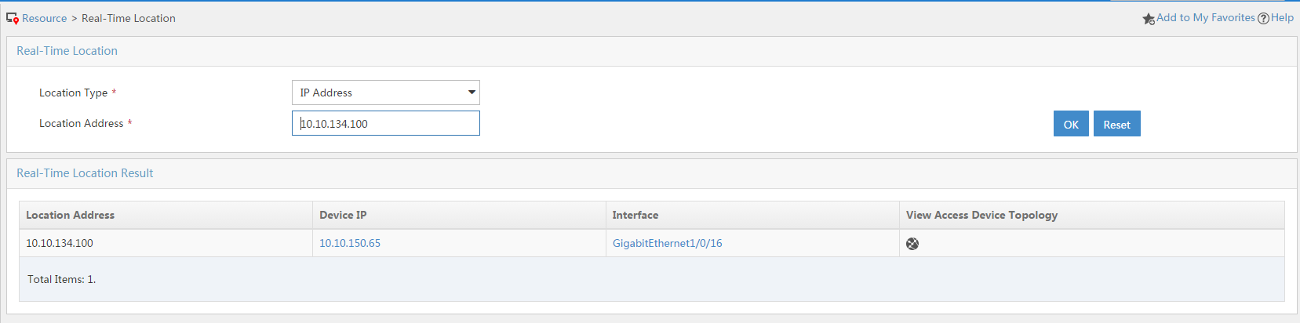
Scenario 1: Simple Connection issue
Admin team diagnostic
If we’re not lucky (not an authenticated user) we need to ask him his IP address and then we can find him

Slide 18
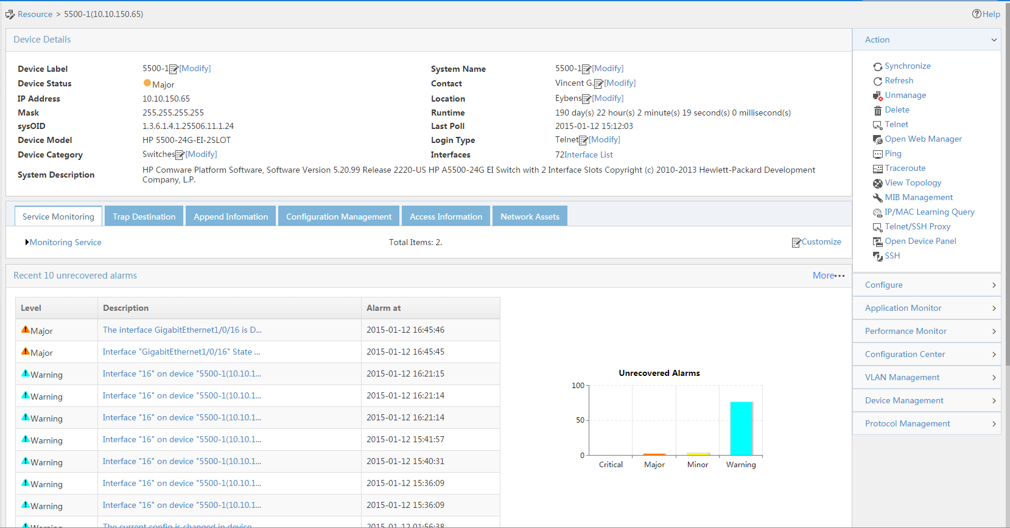
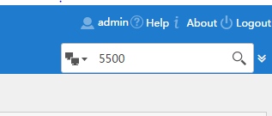
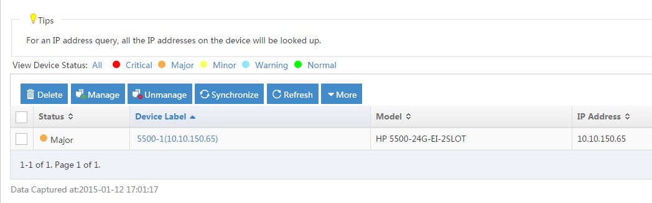
Scenario 1: Simple Connection issue
Admin team diagnostic
Let’s find this device / port
Apparently there is an issue with this port GigabitEthernet 1/0/16 …
Let’s check (click on the alarm)

Slide 19
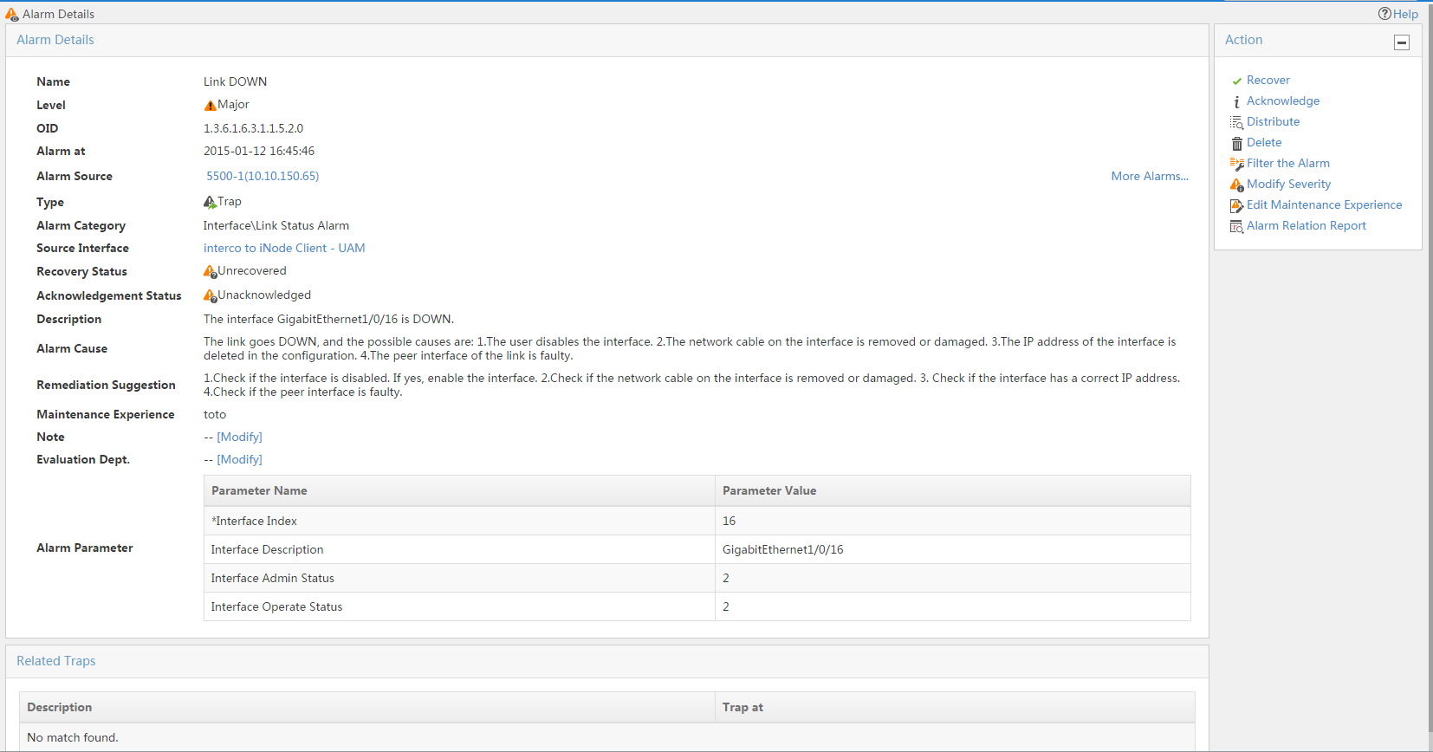
Scenario 1: Simple Connection issue
Admin team diagnostic
Apparently, interface is down
iMC suggest to first check if the interface is disabled, then verify the cable …
So let’s click on the interface

Slide 20
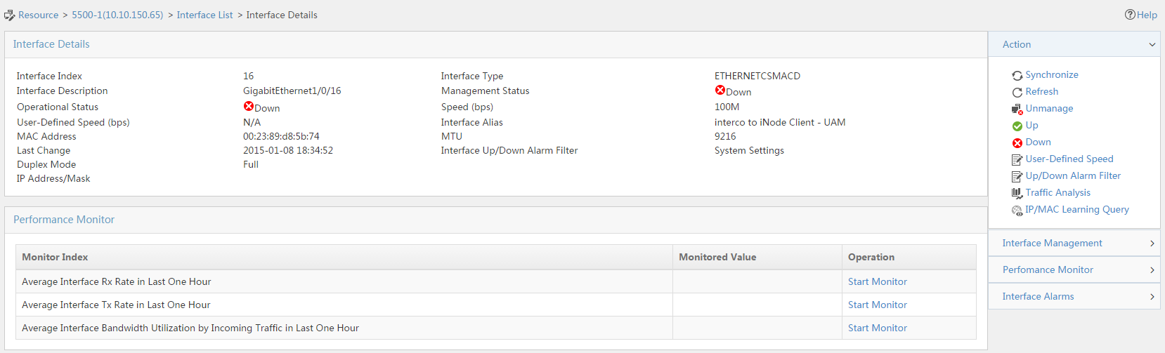
Scenario 1: Simple Connection issue
Admin team : Fix
YES … We got it. Admin status is DOWN.
So let’s make it up back

Slide 21
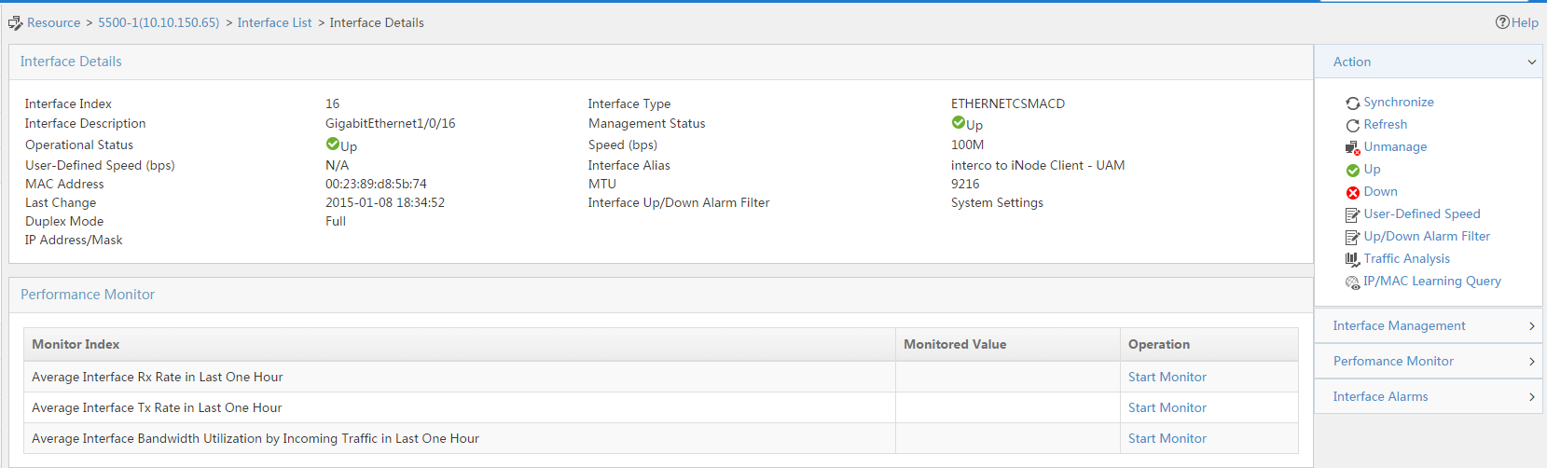
Scenario 1: Simple Connection issue
Admin team : Fix
After few seconds, Admin Status and Operational Status show as UP → Issue fixed (apparently)

Slide 22
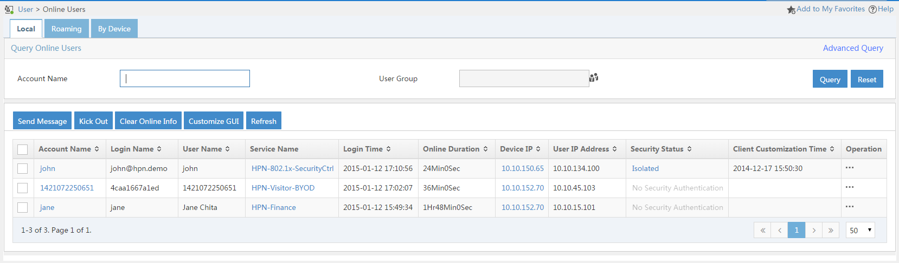
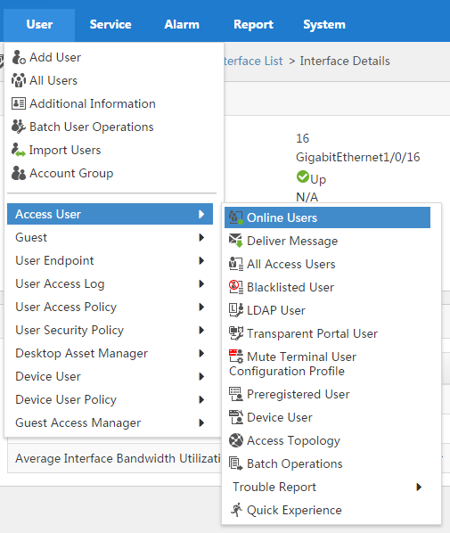
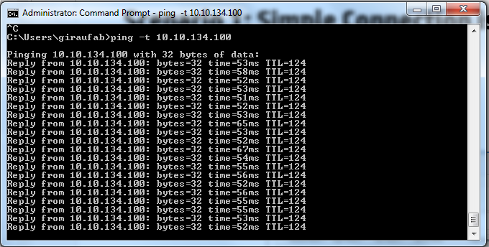
Scenario 1: Simple Connection issue
Admin team : Check
Let’s make some test
Find John in the online users to check he is connected
Try to ping his IP address

Slide 23
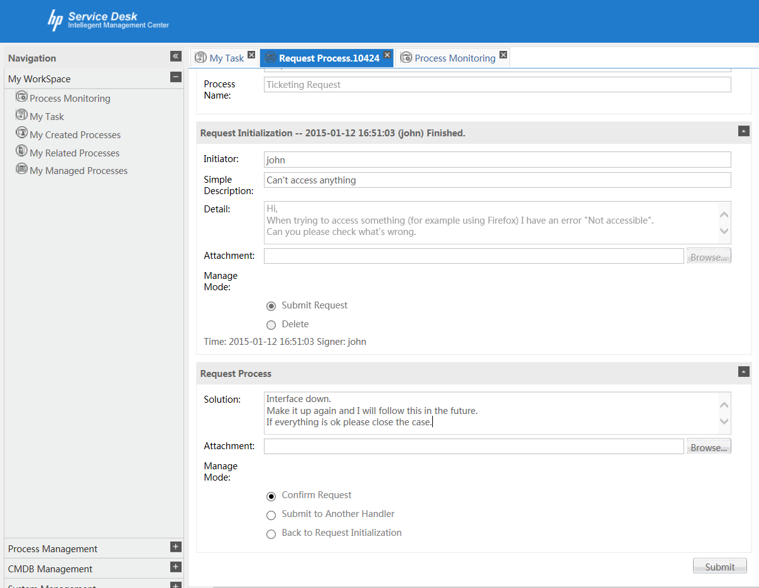
Scenario 1: Simple Connection issue
Admin team : Close the case
Fill in the solution in the case and ask John to close (if everything is ok)

Slide 24
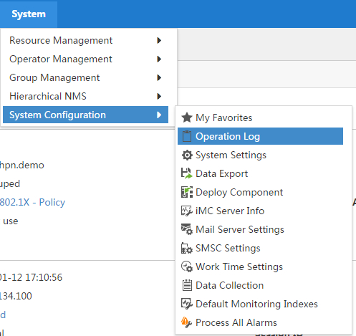
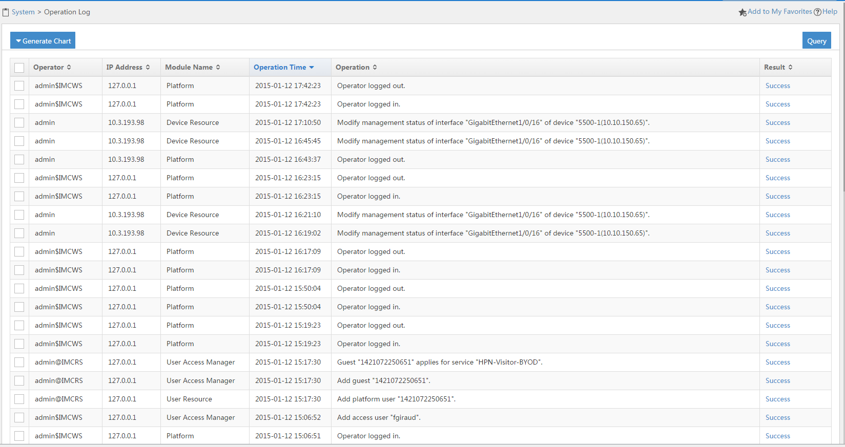
Scenario 1: Simple Connection issue
Admin team : Check (who did it ?)
Check in the iMC logs if you can see who shutdown the port

Slide 25
AGENDA
Scenario 1
Detect
Diagnose
Fix
Check
Scenario 2
Detect
Diagnose
Fix
Check
Scenario 3
Detect
Diagnose
Fix
Check
Notes:
If time, show the event correlation (root cause)

Slide 26
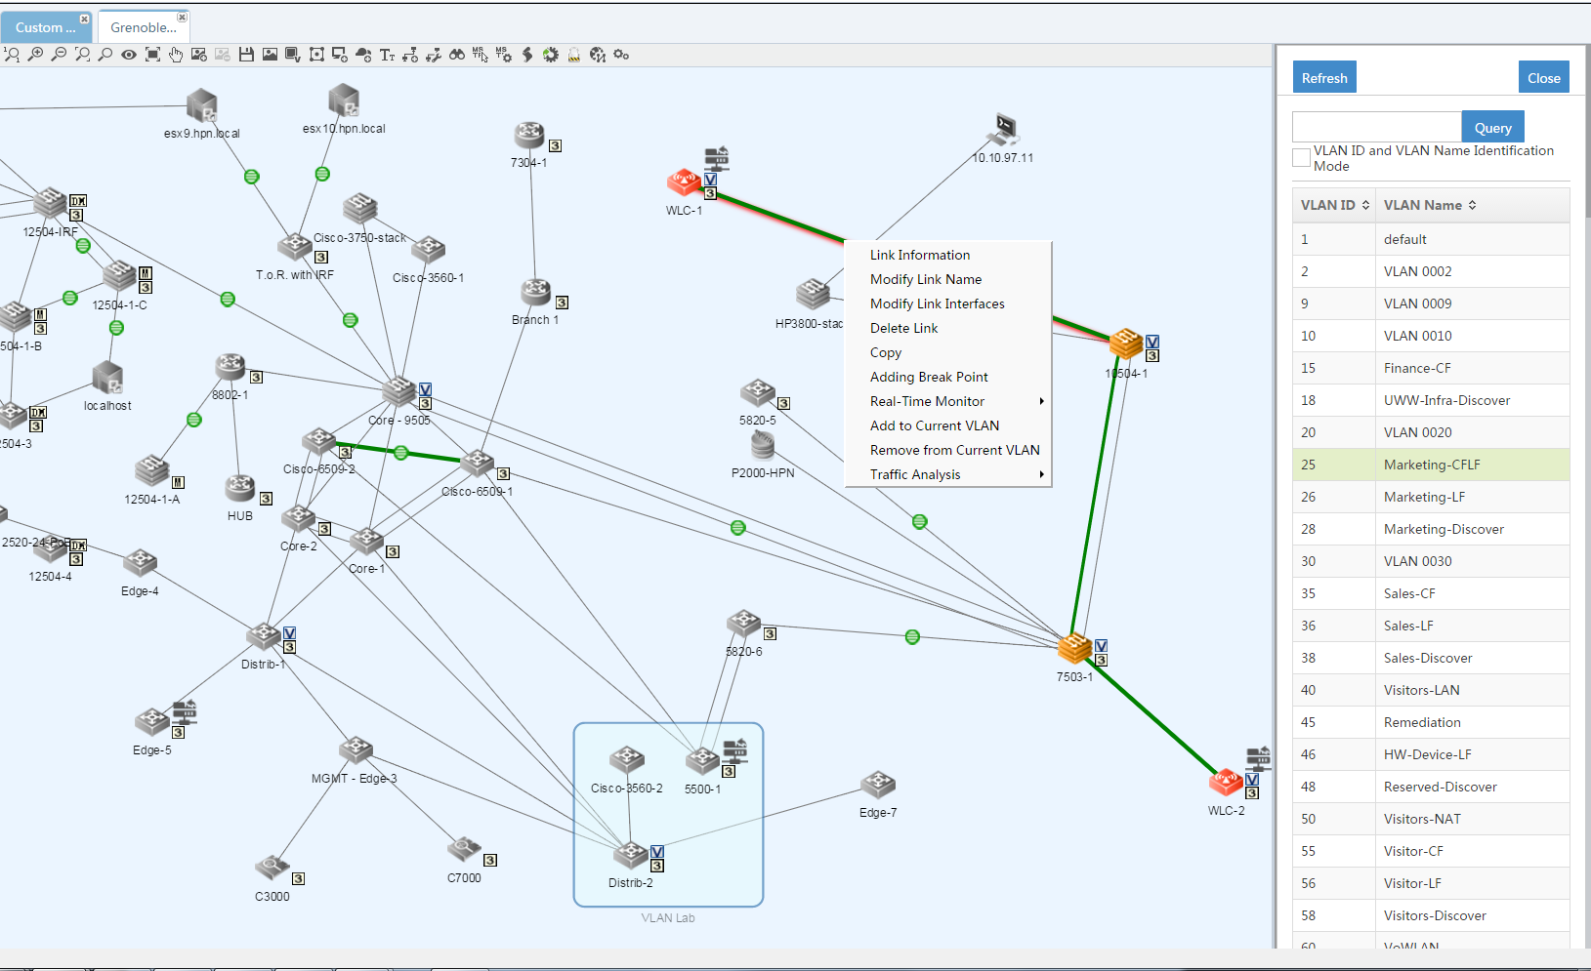
Demoer Task : Remove vlan 25 on a link
On the Custom Topology « Grenoble – Eybens Dynamic » Remove from Current Vlan the link between WLC-1 and 10504-1

Slide 27
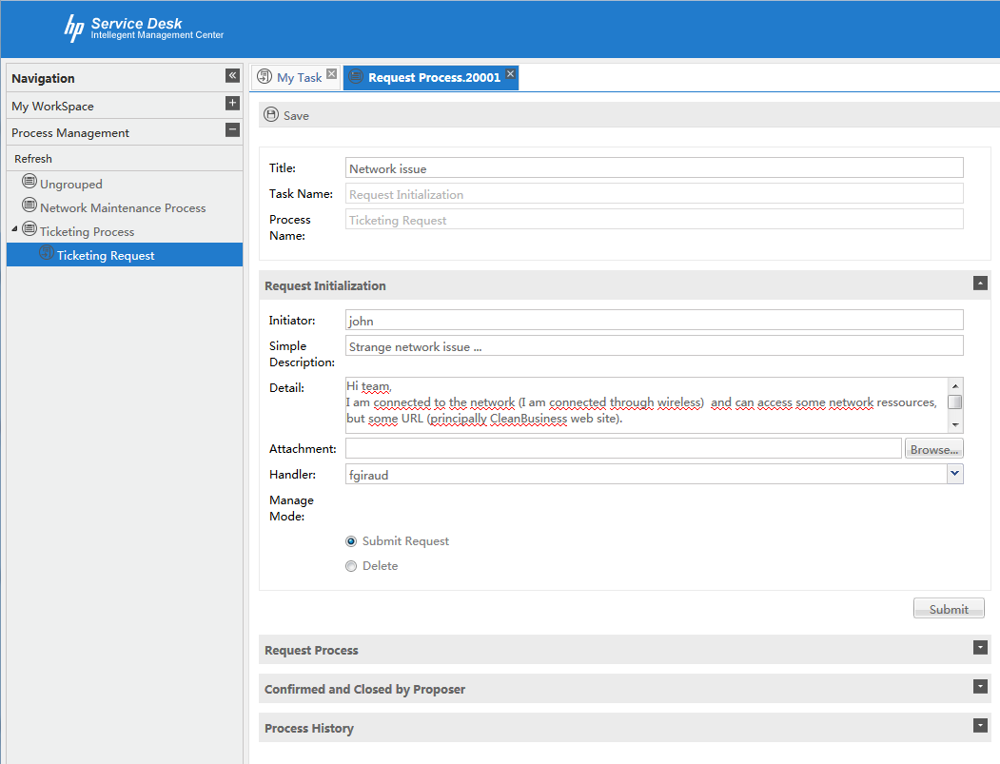
Scenario 2: More complex connection issue
End user detects an issue
The end user John has access to the network but can’t access some URL. Principally he can’t access the Intranet Corporate WebSite: CleanBusiness
Notes:
Username: john / Password : hpn

Slide 28
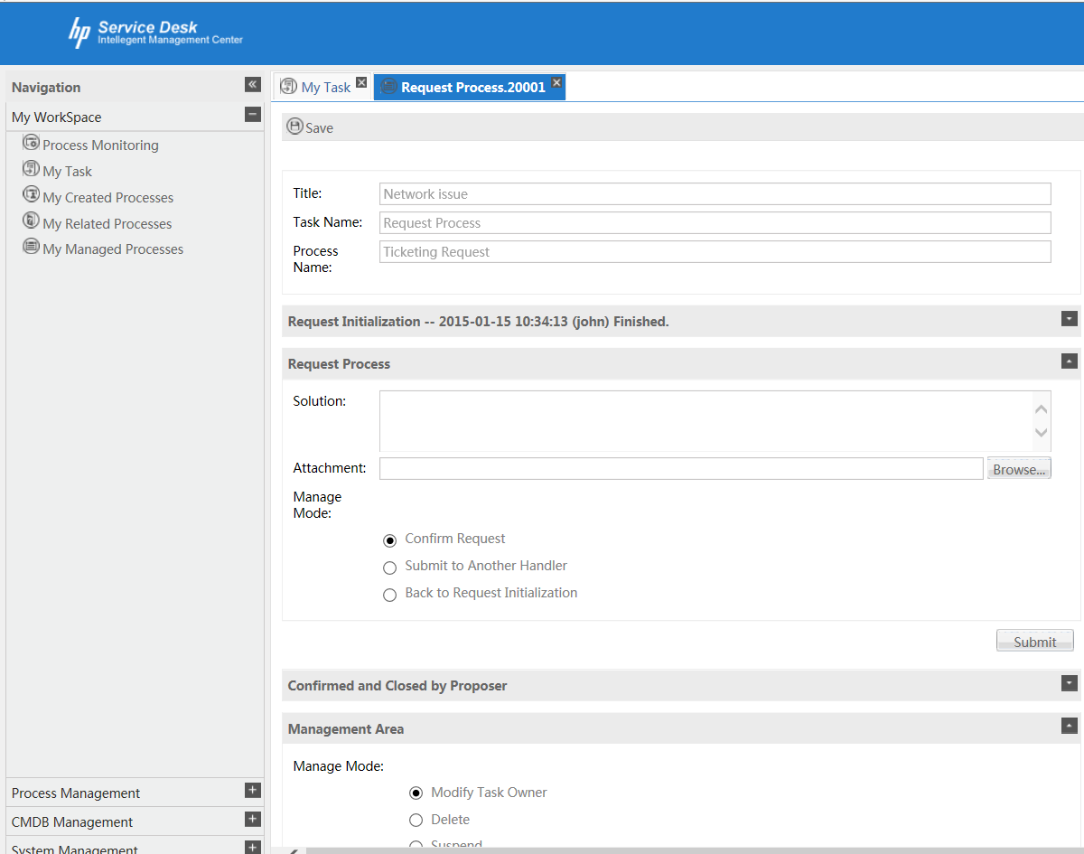
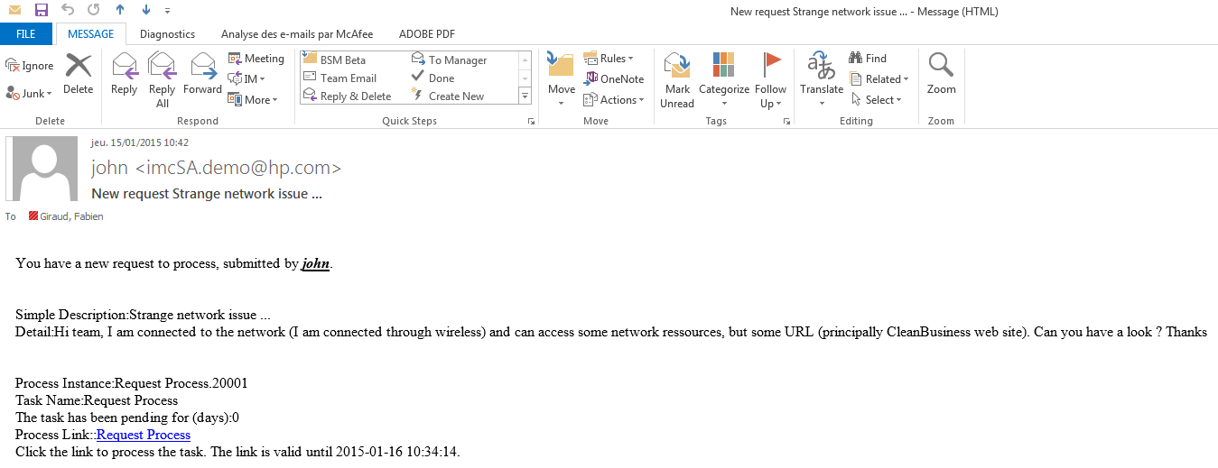
Scenario 2 : More complex connection issue
Admin team diagnostic
The Network support team receives an email:
Notes:
If needed, connect with network support user such as fgiraud / hpn or clinzell / hpn

Slide 29
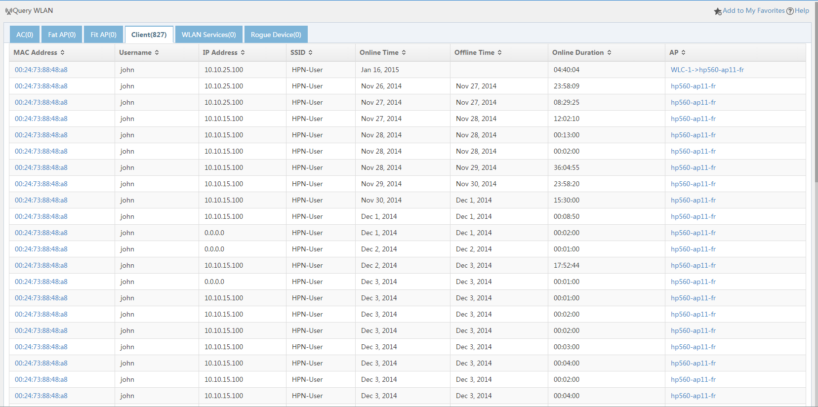
Scenario 2 : More complex connection issue
Admin team diagnostic : Client Side
Some interesting details in the ticket. First one: wireless client
→ Let’s search it
Apparently he is still online and connected on AP : hp560-ap11-fr

Slide 30
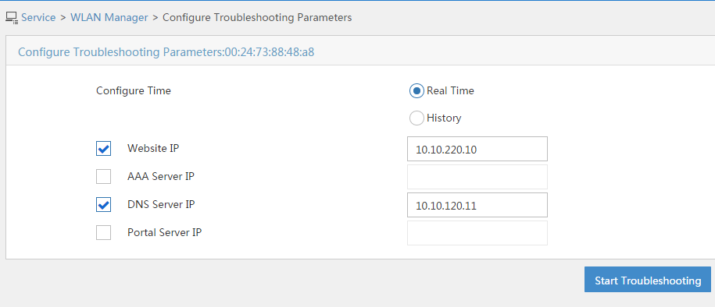
Scenario 2 : More complex connection issue
Admin team diagnostic – Client Side: Troubleshooting feature (1)
Let’s diagnose if it is a wireless issue using the « Search Troubleshooting » feature
We’ll check access to the web site and DNS

Slide 31
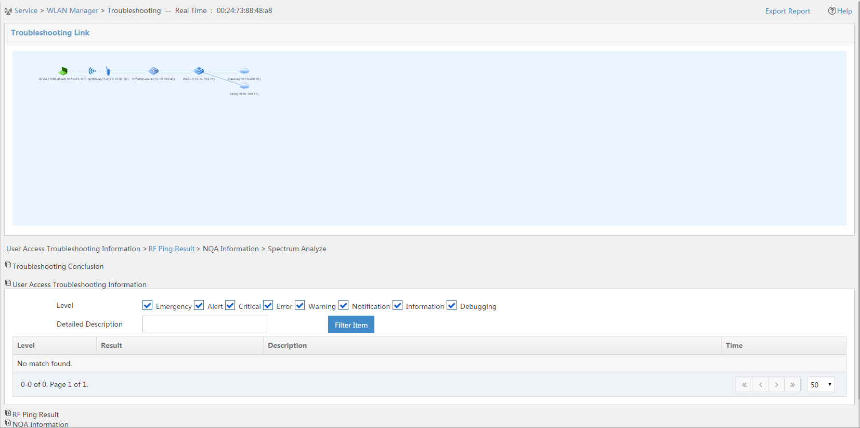
Scenario 2 : More complex connection issue
Admin team diagnostic – Client Side: Troubleshooting feature (2)
We can see the path used to communicate to DNS server and Website and if there is some issue with the access user
No Alarm at this point

Slide 32
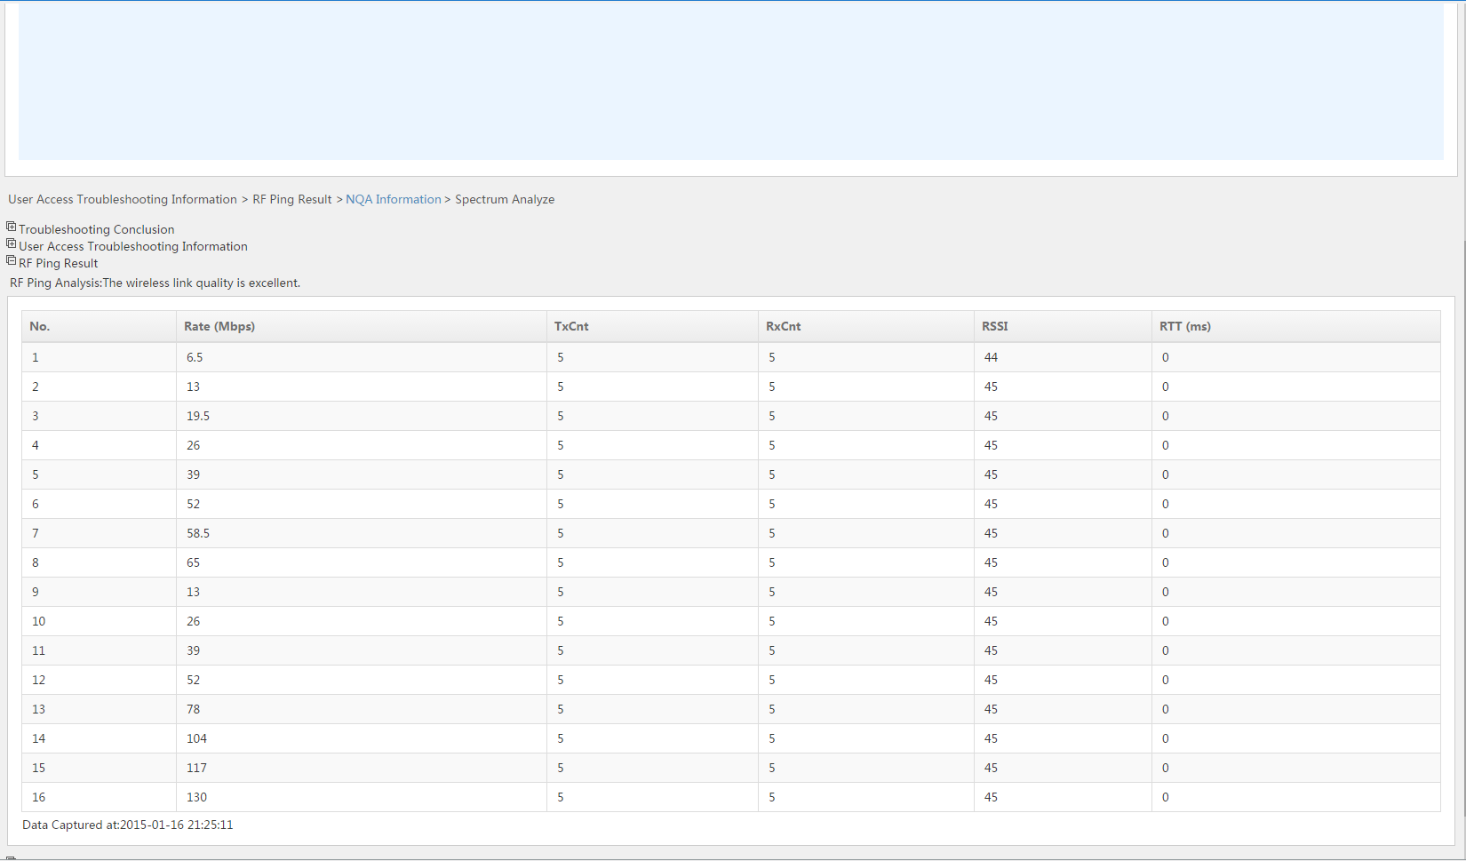
Scenario 2 : More complex connection issue
Admin team diagnostic – Client Side: Troubleshooting feature (3)
By clicking on RF Ping, we can see if there are some issue between AP and client
Still NO ISSUE (wireless link quality excellent !!!)

Slide 33
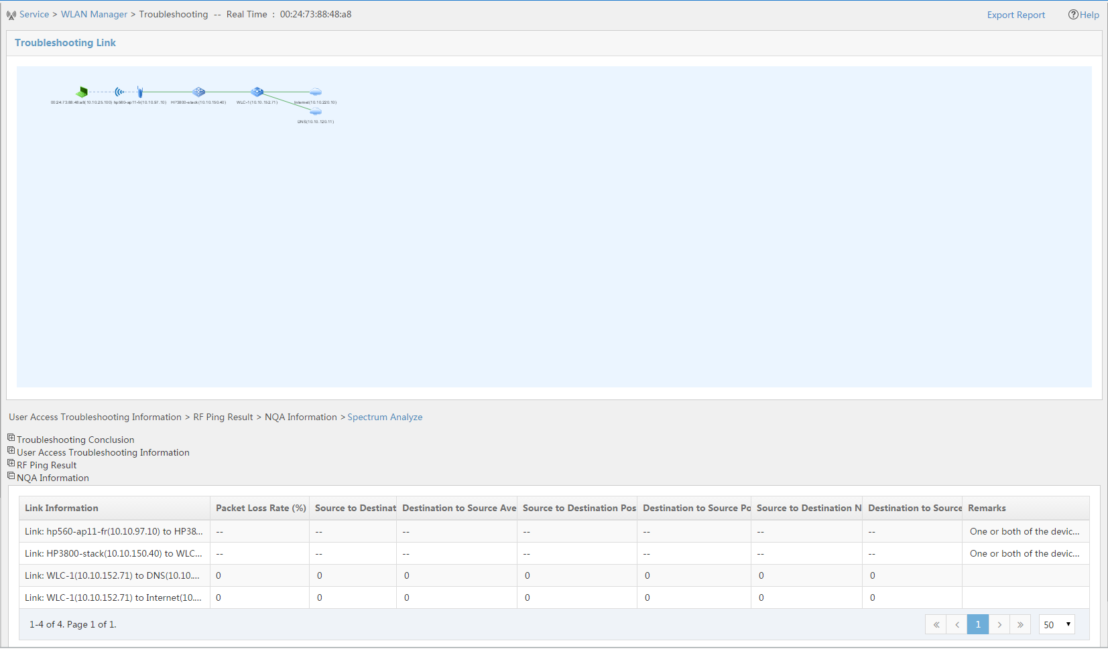
Scenario 2 : More complex connection issue
Admin team diagnostic – Client Side: Troubleshooting feature (4)
The issue is still not there
Clicking on NQA information will make some NQA test along the path
Average Delay
Positive Jitter
Negative Jitter
One of the devices does not support NQA

Slide 34
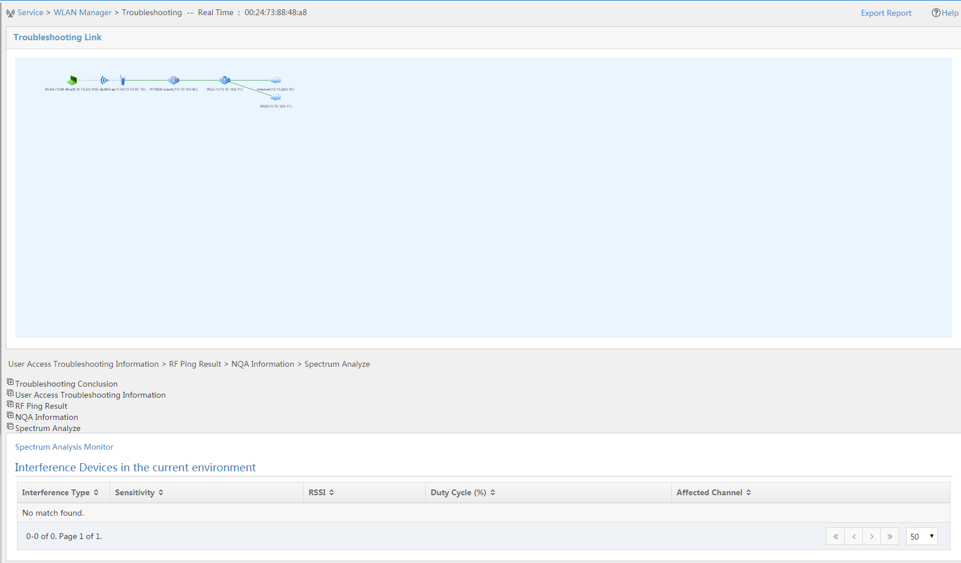
Scenario 2 : More complex connection issue
Admin team diagnostic – Client Side: Troubleshooting feature (5)
No interference → we need to search otherwhere
Let’s finish with Spectrum Analysis to verify there is no interference

Slide 35
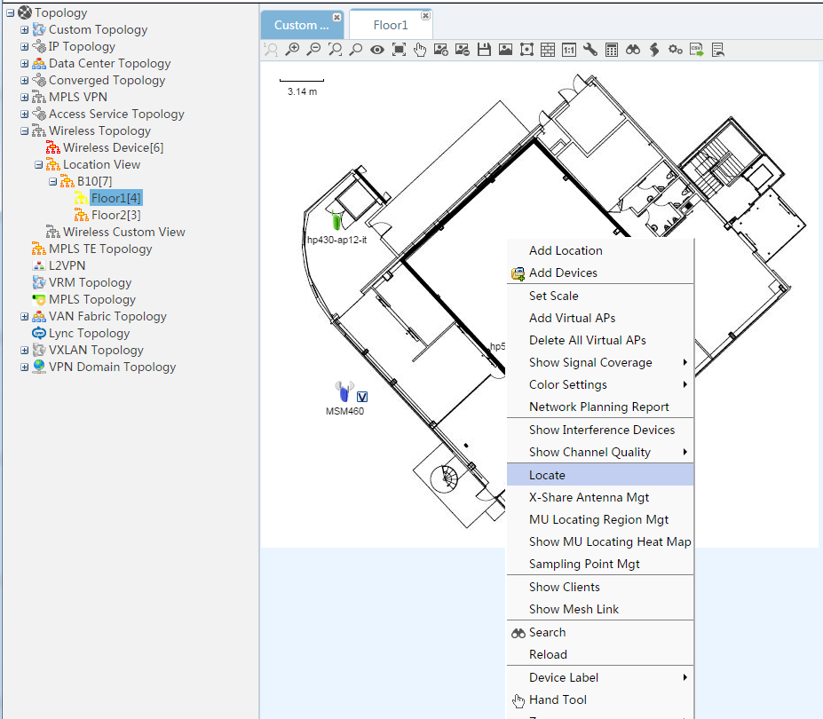
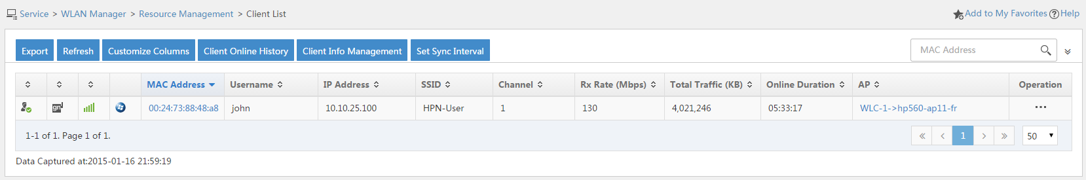
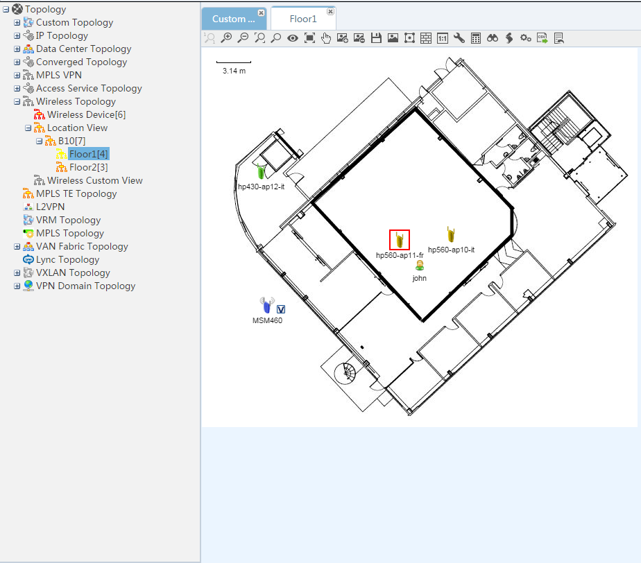
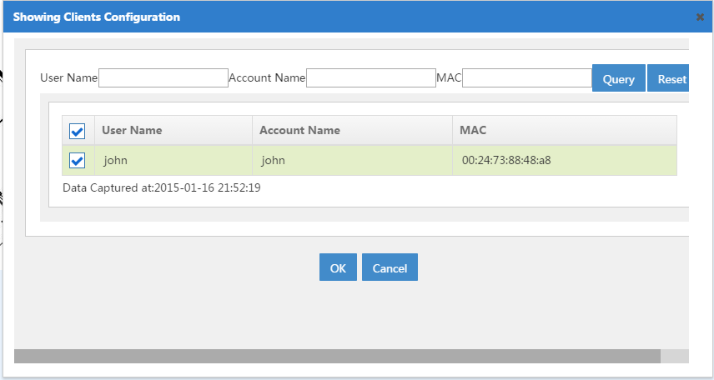
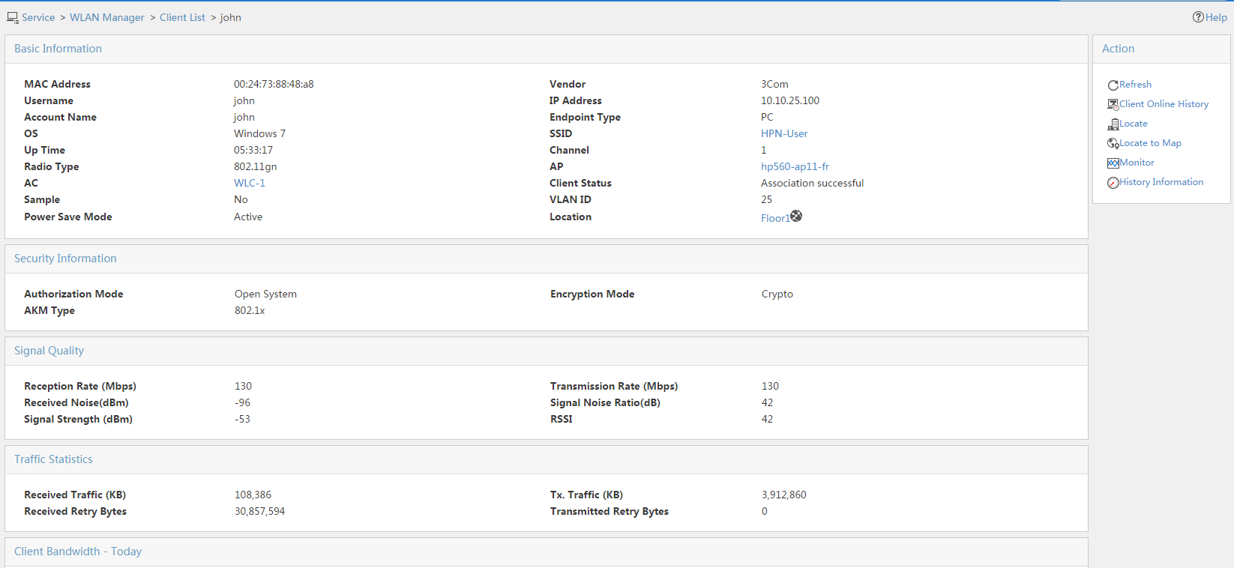
Scenario 2 : More complex connection issue
Admin team diagnostic – Client Side: just for fun
Where is the user and what kind of device is he using ???

Slide 36
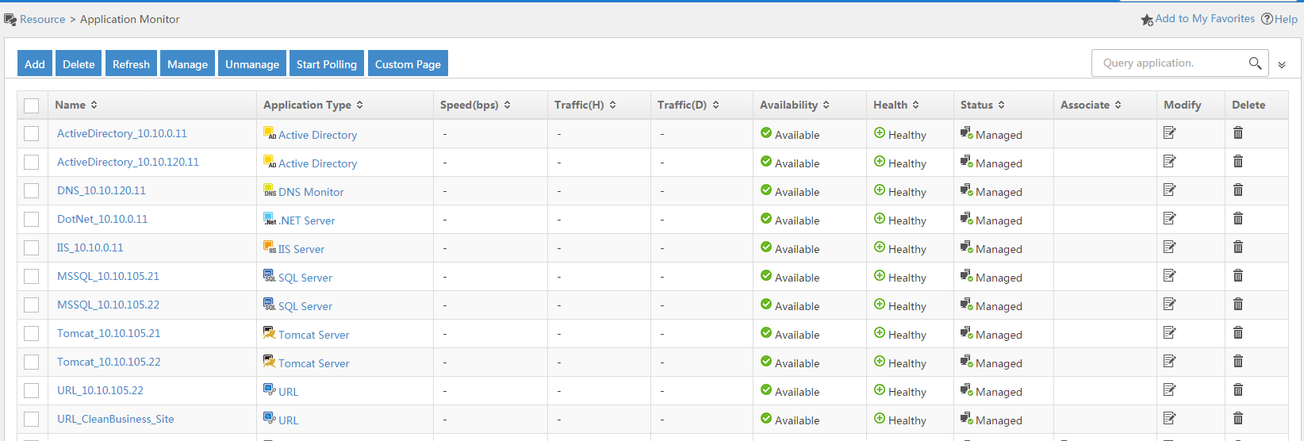
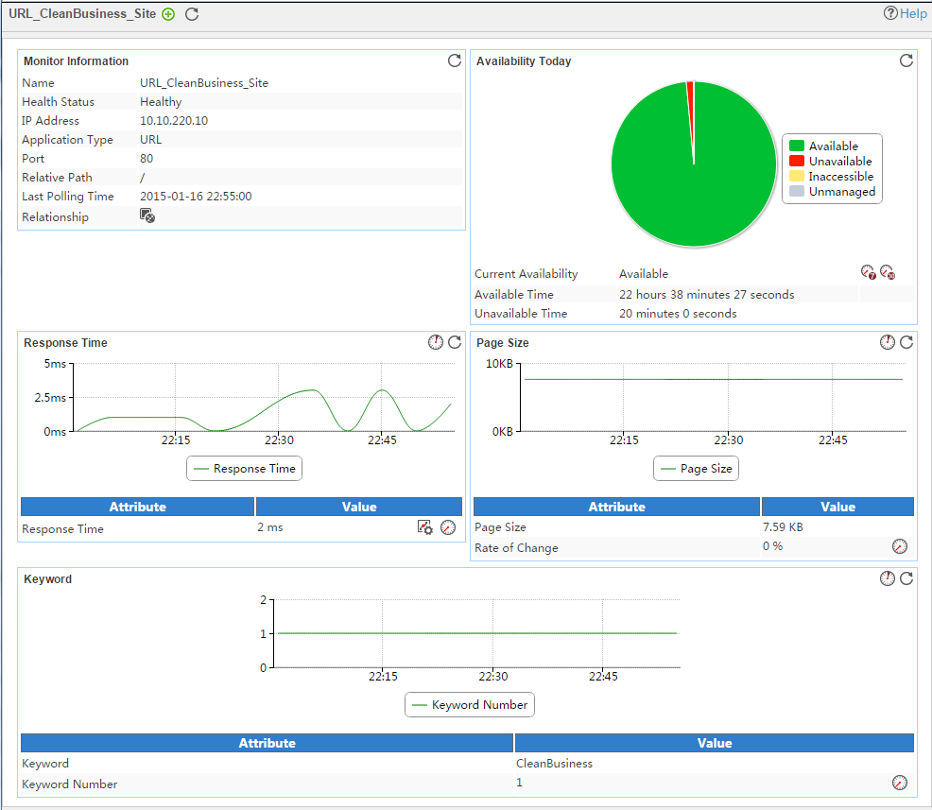
Scenario 2 : More complex connection issue
Admin team diagnostic – Intranet Site Side
The other interesting point in the case: « principal issue = no access to CleanBusiness web site »
We monitor it in APM → check
Working fine

Slide 37
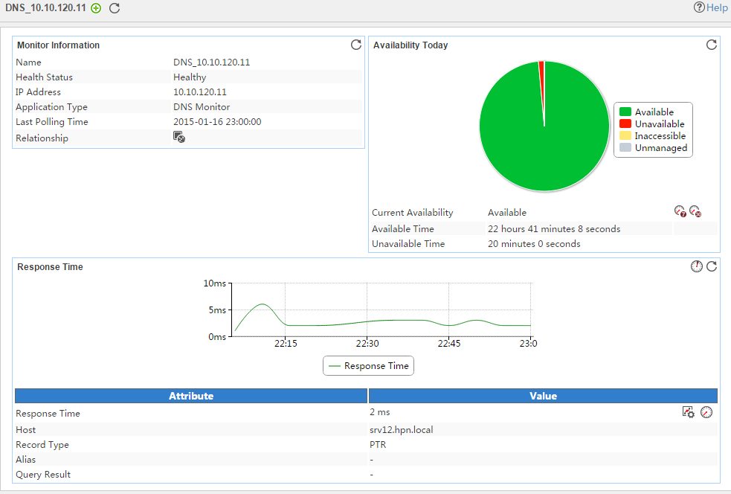
Scenario 2 : More complex connection issue
Admin team diagnostic – DNS Side
Perhaps this is a DNS issue … Let’s check in APM
Also working fine

Slide 38
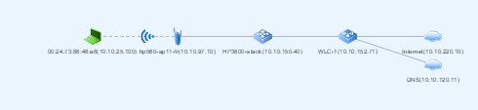
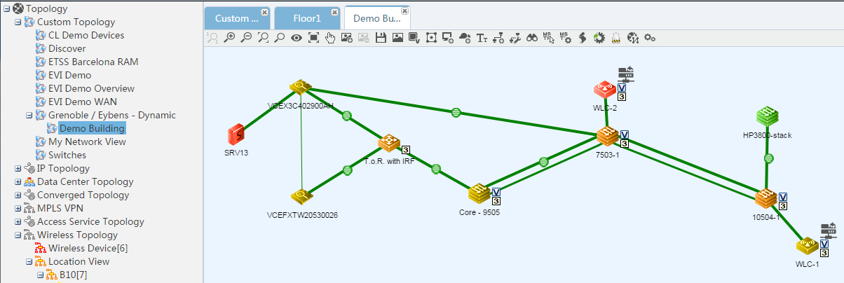
Scenario 2 : More complex connection issue
Admin team diagnostic – Issue between Client and Intranet Site
Let’s check if there is some configuration issue between the client and the URL
Remember, the path found previously:
So let’s find it on a map (Demo Building custom topology)
No alarm on the links

Slide 39
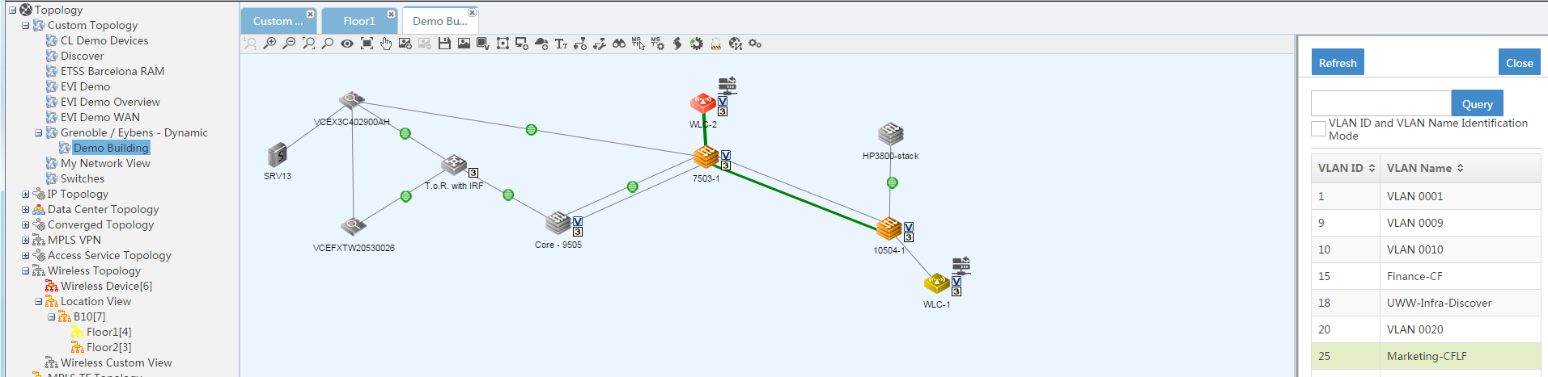
Scenario 2 : More complex connection issue
Admin team diagnostic – Issue between Client and Intranet Site
Let’s check VLAN (25) configuration in this path
WE FOUND IT : VLAN 25 is not allowed between 10504-1 and WLC-1

Slide 40
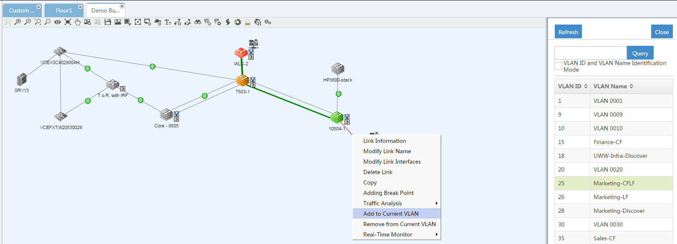
Scenario 2 : More complex connection issue
Fix
Need to allow VLAN 25 on this link … So easy ☺

Slide 41
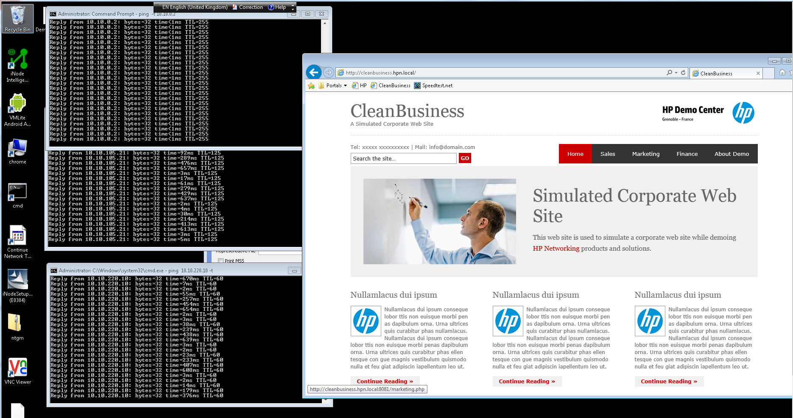
Scenario 2 : More complex connection issue
Check
If we connect on the customer PC, we can see that now cleanbusiness is accessible … Well done. We can close the case
Notes:
Connect to 10,10,0,98 and open http://cleanbusiness.hpn.local/ to check

Slide 42
AGENDA
Scenario 1
Detect
Diagnose
Fix
Check
Scenario 2
Detect
Diagnose
Fix
Check
Scenario 3
Detect
Diagnose
Fix
Check
Notes:
If time, show the event correlation (root cause)

Slide 43

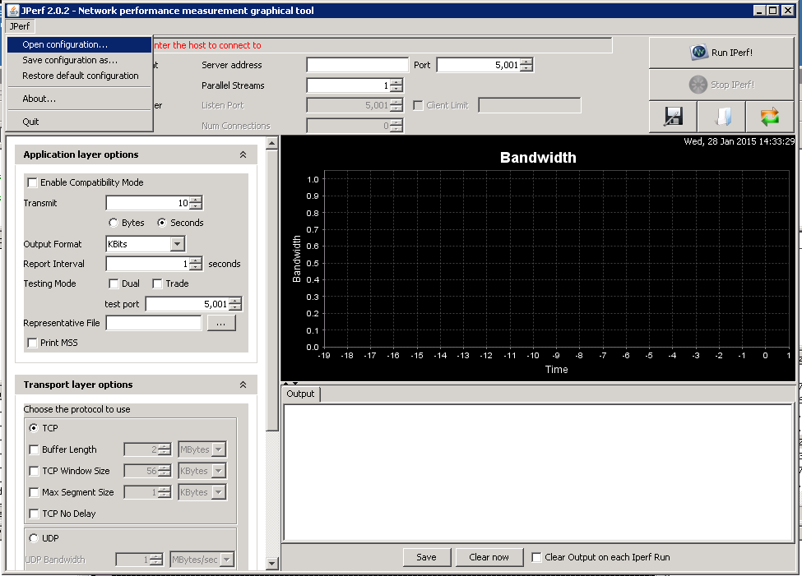
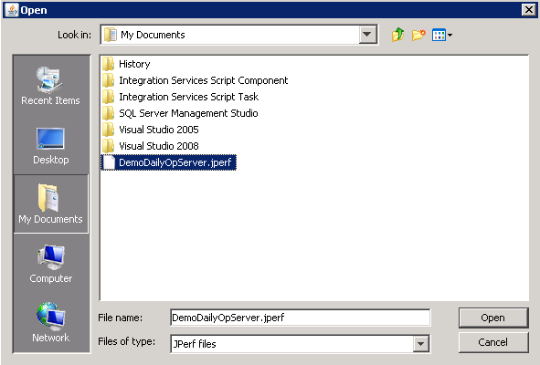

Demoer Task : Start Jperf (server)
RDP on server 10.10.105.22 (administrator user)
Start JPERF (shortlink on the desktop):
Open configuration file named « DemoDailyOpServer.jperf » (located in My Documents)
Start Iperf by clicking on the corresponding button:

Slide 44



Demoer Task : Start CPUStress
RDP on server 10.10.105.22 (administrator user)
Start CPUSTRESS (shortlink on the desktop) 4 times:
In each CPUSTRESS windows activate the 4 threads (by selecting each one), and put activity level to « Maximum »
At the end, the CPU load on the server should be arround 100%

Slide 45

Demoer Task : Start Jperf (server)
RDP on server 10.10.0.98 (administrator user)
Start JPERF (shortlink on the desktop):
Open configuration file named « DemoDailyOpServer.jperf » (located in My Documents)
Start Iperf by clicking on the corresponding button:

Slide 46



Scenario 3: Proactive detection
Automatic detection: multiple ways
Admin Team receives an email with some alarm on link usage
In the NOC room, the Demo Building Network swap to yellow color
In the alarm browser of the admin team: some Link usage alarms !!!
Notes:
Verify perf data + verify topology + …

Slide 47



Scenario 3: Proactive Detection
Diagnose: alarm details
And also in live
Open the alarm details: seems that some links are over used
Click on Performance data to view when this began

Slide 48


Scenario 3: Proactive Detection
Diagnose: Topology
We can also see something is hapenning on the topology (Demo Building)
And see real time monitoring

Slide 49


Scenario 3: Proactive Detection
Diagnose: Topology
And also (NEW !) we can already check which kind of application is generating « strange » traffic

Slide 50


Scenario 3: Proactive Detection
Diagnose: Who, what and Why ?
Let’s find know which kind of traffic it is … using NTA

Slide 51



Scenario 3: Proactive Detection
Diagnose: Who, what and Why ?
Type of traffic:
DevilOne traffic is between these two !
And this is my server SRV13

Slide 52


Scenario 3: Proactive Detection
Diagnose: Who, what and Why ?
Other talkers ?
The second top talker session is more « normal »

Slide 53

Scenario 3: Proactive Detection
Fix: 1rst option → ACL
One way to fix should be to add an ACL directly from iMC (using the 2 ip address we detected before)
And to deploy it on the switch

Slide 54

Scenario 3: Proactive Detection
Fix: 2nd option – Diagnose a little bit more
Another clever option should be to check if it is an authenticated user (so we can blaim him and disconnect ☺) → UBA
Apparently, this is John who is the devil

Slide 55



Scenario 3: Proactive Detection
Fix: 2nd option → Kick Out
Find John in the online users:
First we blacklist the user (since on many OS, wireless reconnects automatically)
And then we can kickout

Slide 56


Scenario 3: Proactive Detection
Check
On the real-time monitoring we see the traffic going done / And on the client computer : disconnected …

Slide 57

Note for demoer
Don’t forget to unblacklist john at the end of the demo

Slide 58
Scenario 3: Proactive Detection
Check
When trying to access http://10.10.105.22/imc it seems still slow
By the way there was another interesting alarm in the alarm browser …
Seems that the server is overloaded … So let’s see more details

Slide 59


Scenario 3: Proactive Detection
Diagnose: application monitoring
Alarm details check …
Many services should be impacted by this one … including the URL we tested !

Slide 60


Scenario 3: Proactive Detection
Diagnose:

Slide 61

Scenario 3: Proactive Detection
Diagnose:
Apparently CPUSTRES.EXE process is using all the CPU !
Need to kill it

Slide 62

Scenario 3: Proactive Detection
Fix
Kill CPUSTRESS application

Slide 63

Scenario 3: Proactive Detection
Check
APP monitoring is now ok
And URL accessible fine

Slide 64

Scenario 3: Bonus Track
Compliance Report
Check compliancy of the device configurations
Customizable

Slide 65

Scenario 3: Bonus Track
Network Inspection (SHM)
Check the health of the network (CPU, speed, OSPF routes number …)
Customizable
Report available: HTML, Word, PDF

Slide 66

Scenario 3: Bonus Track
BSD – Business Service Dashboard (Available Q4FY15)
Overview of corporate services (combine network, applications, servers …)
Health & availability
Details (capacity planning, alarms, topology …)

Slide 67





Scenario 3: Bonus Track
BSD – Business Service Dashboard (Available Q4FY15)

Slide 68

Please give us your feedback!

Slide 69
Thank you
Contact information

